Slide 1
2D Trajectory prediction of tennis ball throws
Hamza Zareen
(IS/106/BSCS/B/E/A-14)
Supervised by: Mr. Nouman Qadeer

Slide 2
Major functions completed
The most important feature “Detection of tennis ball throws is done” using image differencing and using morphological operators.
Dataset of the detection is stored into the excel file.
Prediction ( Kalman filter).
First its done using x-axis and y-axis separately.
Then its done using both x-axis and y-axis.

Slide 3
Methodology
Reading video file by browsing it in from the computer.
Now checking that the video has frames or not and count its frame.
Now from the counted frames applying the detection procedure to bunch of frames.
Then a single frame is cropped with a specific rectangle to limit objects in the image the same rectangle will be used for all images.
Then the difference of the image is taken from which we will get the objects which are in motion at that time.
Then the image is converted into RGB to gray.

Slide 4
Methodology cont.
Then the image is converted into a binary image.
Then a structuring element is set to dilate the resultant image.
Then with another structuring element is used to close the objects which are separated while applying the differencing procedure.
Then a function is used which will eliminate those objects which has pixels less than 30.
Then we will fill the holes like by applying these procedures there may have objects which has holes in them so we will fill those holes.

Slide 5
Methodology cont.
Then we will apply another morphological operator image open to open those objects which are been combined during this procedure.
Now we use the equation to find the circle type objects.
Then we will apply the threshold value that the object greater than .75 values which will be calculated by the equation will be a ball.
Then the ball centroid like its center pixel is detected.

Slide 6
Methodology cont.
The detected centroid values like x and y axis coordinates are then send to excel file to be used for the prediction purpose.
These all procedures will apply for all frames to detect the ball.
To predict the next ball coordinates or missing coordinates first the x axis and y axis both excel files are loaded in Matlab.
Then the Kalman filter is used to predict the coordinates like if there is no coordinates of ball are present then it will only predict the ball at that position and if there are coordinates of ball in file then it will first predict the location then correct the position of the ball by using its equations.

Slide 7
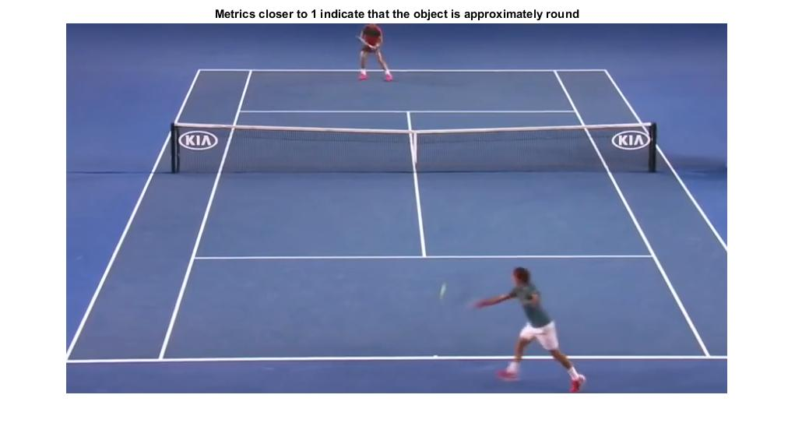
Cropped Image

Slide 8
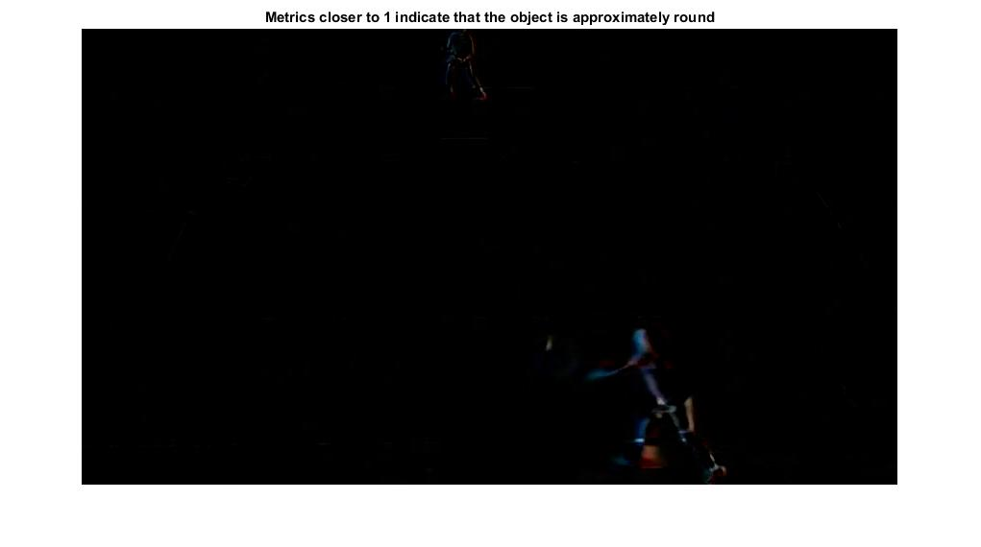
Difference of Image

Slide 9
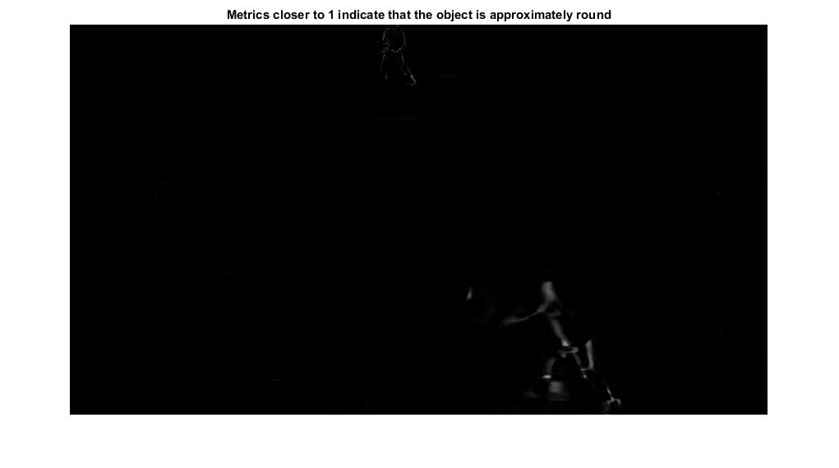
Gray Scale Image

Slide 10
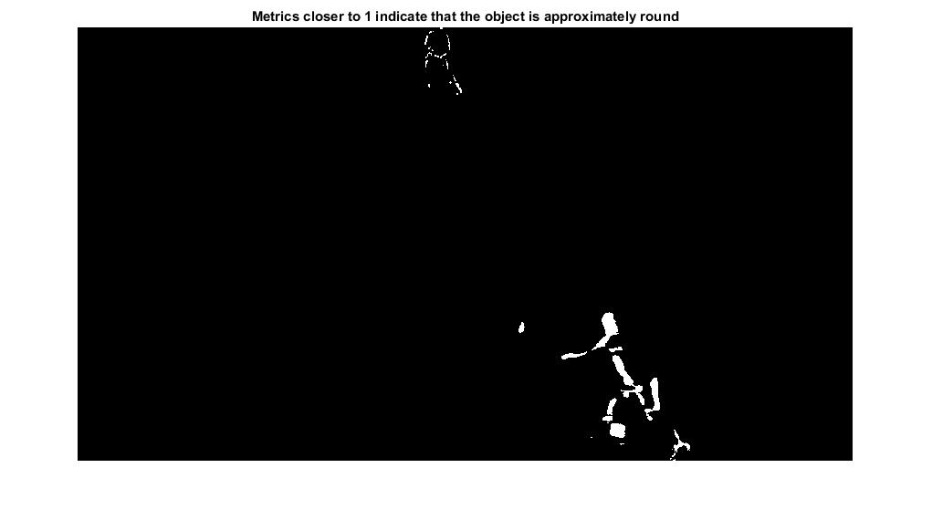
Binary Image

Slide 11
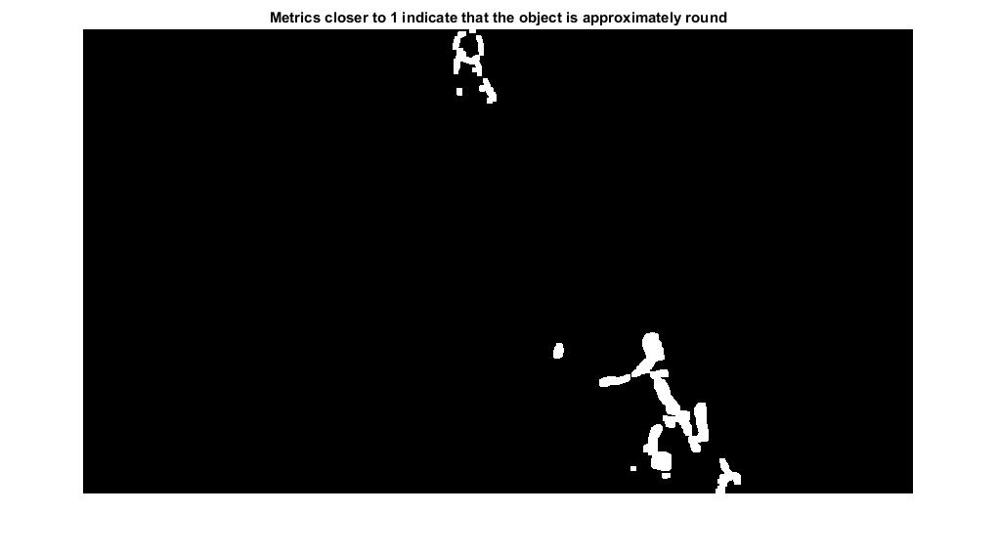
Dilated Image(morphological dilation operation)

Slide 12
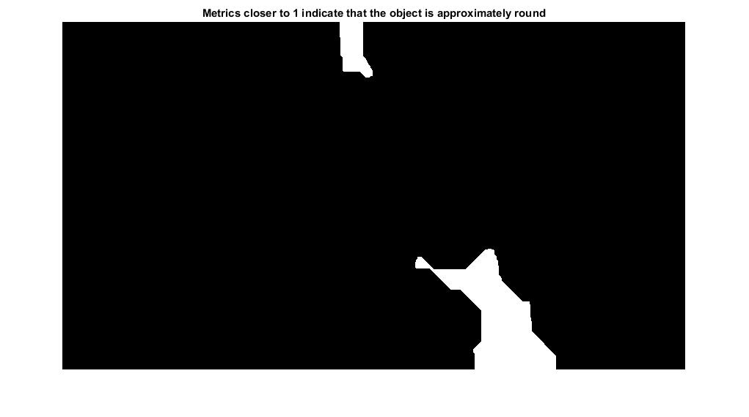
Closed Image(morphological closing operation)

Slide 13
Area Open Image

Slide 14
Filling Holes

Slide 15

Opening the Image(morphological opening operation)

Slide 16
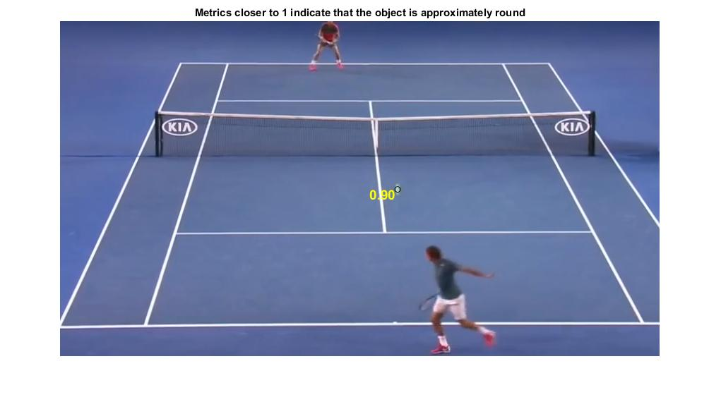
Applying Circle Equation

Slide 17
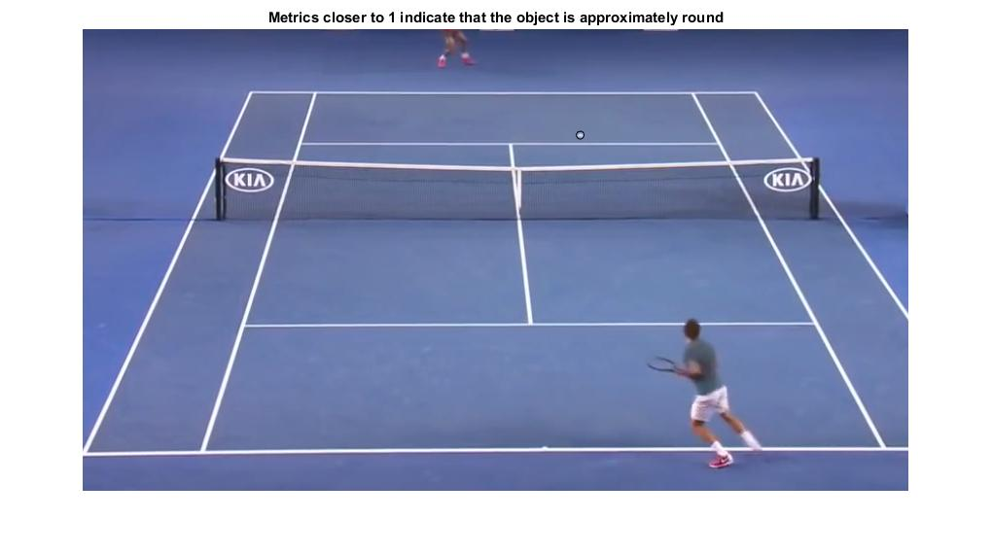
Detection of tennis ball

Slide 18


Slide 19


Slide 20
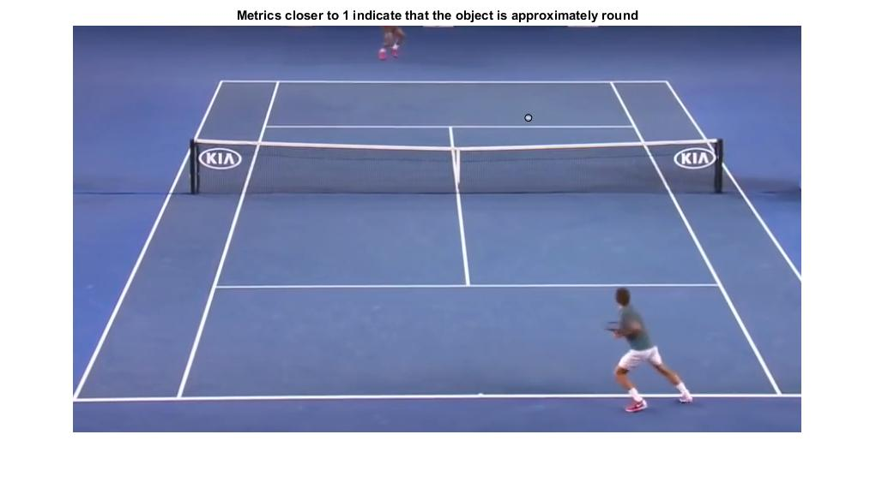

Slide 21


Slide 22


Slide 23


Slide 24
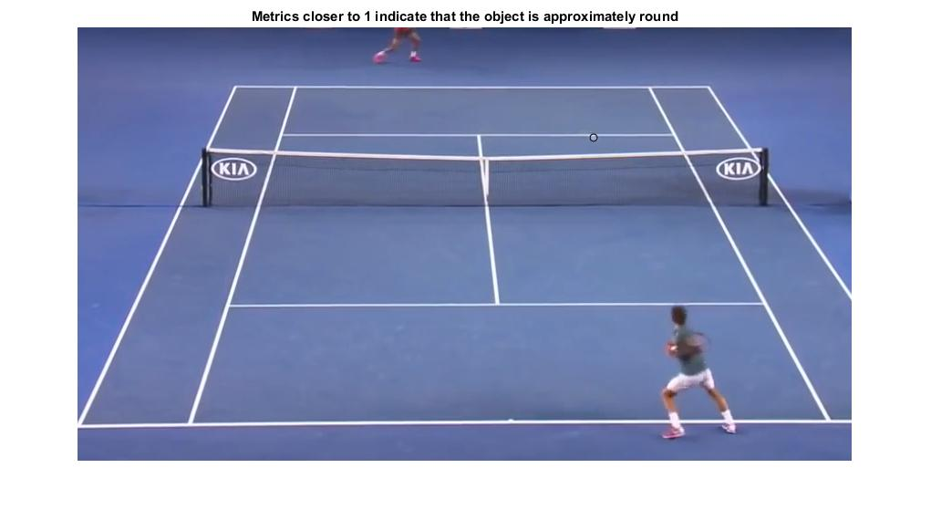

Slide 25
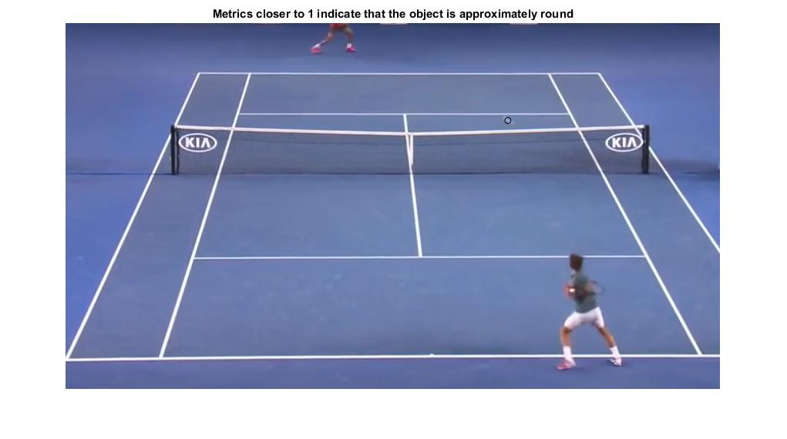

Slide 26


Slide 27
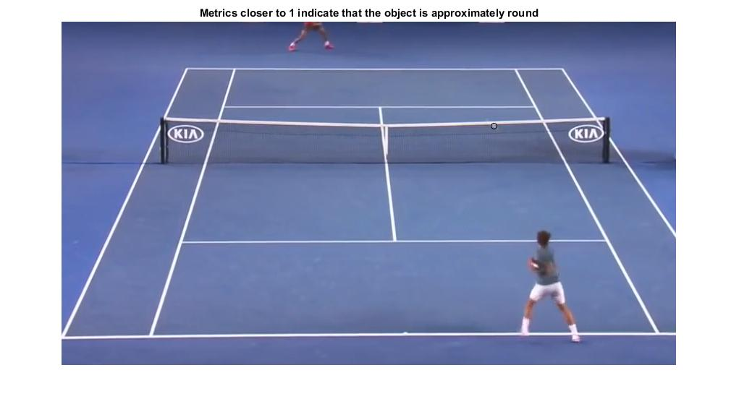

Slide 28
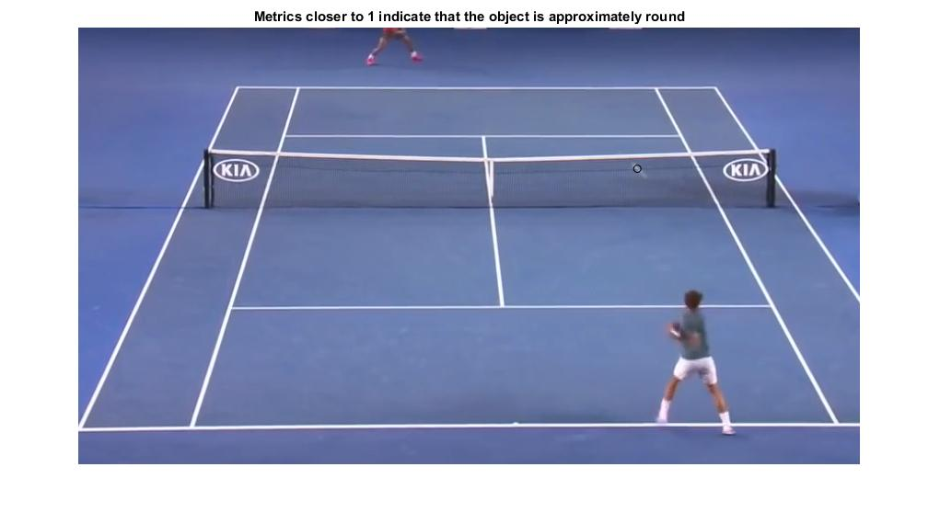

Slide 29


Slide 30
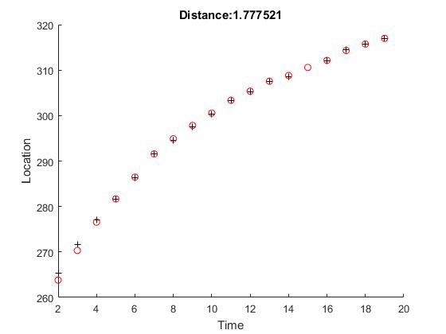
X-axis Graph of Detected and Predicted Data

Slide 31
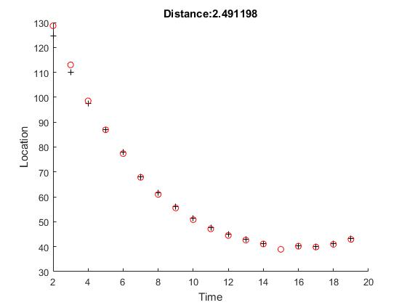
Y-axis Graph of Detected and Predicted Data

Slide 32
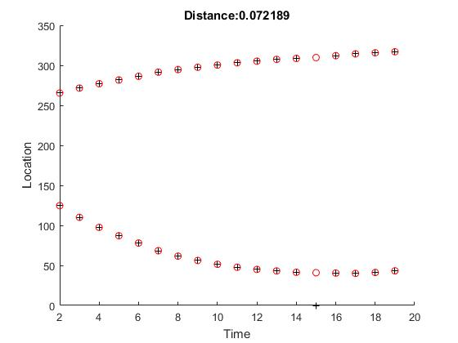
X-axis and Y-axis Graph of Detected and Predicted Data

